Slide 1
BUDGET BUDDY
TEAM 14
David, Josh, Sean, Josh, Adam

Slide 2
INTRODUCTIONS

Slide 3
WHAT IS BUDGET BUDDY?
$
Application intended to assist smaller organizations that don't have a lot of time to deal with budgeting
*Not exclusive to organizations
$
$
Notes:
Adam

Slide 4
FUNCTIONAL REQUIREMENTS
Receipt
Appealing and organized UI
Receipt scanning integration (physical and digital receipts)
Mobile compatible
Organized database
Notes:
Adam

Slide 5
NON-FUNCTIONAL REQUIREMENTS
General financial and investment advice
Scan for potential discounts or sales at particular stores
End-goal: Bank integration (not for a school project though :)
Notes:
Adam

Slide 6
STAKEHOLDERS
Small organizations
School clubs
Sororities and fraternities
Small businesses
Individuals
Broke college students
Families
Notes:
Sean

Slide 7
TREASURER OF UPAC
Present a financial report for a budget meeting
Buy refreshments for next showing
Make a goal to make $100 in ticket sales
Budget Buddy can keep track of the progress on this goal
Keep track of those expenses with the receipt scanner
Budget Buddy can produce a pdf report on all of the organization’s financial records
Notes:
Sean

Slide 8
LOCAL COFFEE SHOP
Keep track of expenses and inventory
Make a goal to pay monthly building rent
Budget Buddy can help manage resources
Buddy can help make sure the business is making enough to pay bills
Notes:
Sean

Slide 9
STUDENT AT RPI
Add a payday option
Ask for help
Be aesthetic
Budget Buddy can remember your payday for you so you don’t have to log it
Budget Buddy can provide basic financial tips (not financial advice)
Excel and Notion simply can’t compete with our frontend efficient design
Notes:
Sean

Slide 10
OUR TECH STACK
ReactJS
MongoDB
Tailwind
Notes:
David

Slide 11
TIMELINE
February
March
April
Get a desktop frontend
Get at least started on backend
Mid Term Presentation
Finish Backend
Implement basic scanning
Mobile frontend
Debug
Notes:
David

Slide 12
IA
Budget Buddy
Resources
(CSS, JS, etc.)
Landing Page
Home Page
Scanning Page
Goals Page
Notes:
David

Slide 13
API Structure
Org
User
Id
Id
User
Id
Budget
Id
Receipt
Id
Purchase
Id
Goal
Id
Notes:
David

Slide 14
Planned API endpoints
endpoint | Get | Post | Put | Delete
/org | IDs of orgs | Create new org | Null | Delete every org (for devs only)
/org/id | Get org info | null | Update org info | Delete that org
/org/user | All users of org | Add user to org | Mass update | Delete all users
/org/user/id | Get user info | null | Update this user | Delete user
/org/budget | All budgets of org | Add budget to org | Mass update | Delete all budget
/org/budget/id | Get budget info | null | Update this budget | Delete budget
/org/receipt | All receipts of org | Add receipt to org | Mass update | Delete all receipt
/org/receipt/id | Get receipt info | null | Update this receipt | Delete this receipt
/org/purchase | All purchases of org | Add purchase to org | Mass update | Delete all purchases
/org/purchase/id | Get purchase info | null | Update this purchase | Delete this purchase
/org/goal | All goals | Add goal to org | Mass update | Delete all goals
/org/goal/id | Get goal info | null | Update this goal | Delete this goal
/user | Get all user IDs | Add new user | Update all users | Delete all users
/user/id | Get user info | null | Update user info | Delete user
Notes:
David

Slide 15
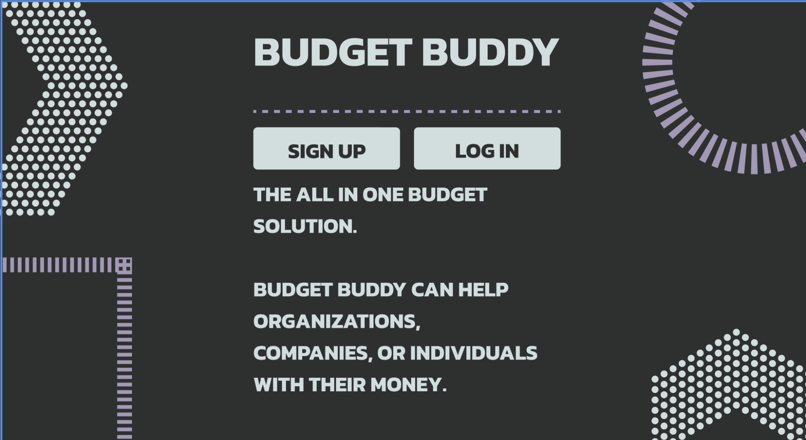
WIREFRAMES (FRONT PAGE)
Notes:
Josh B.

Slide 16
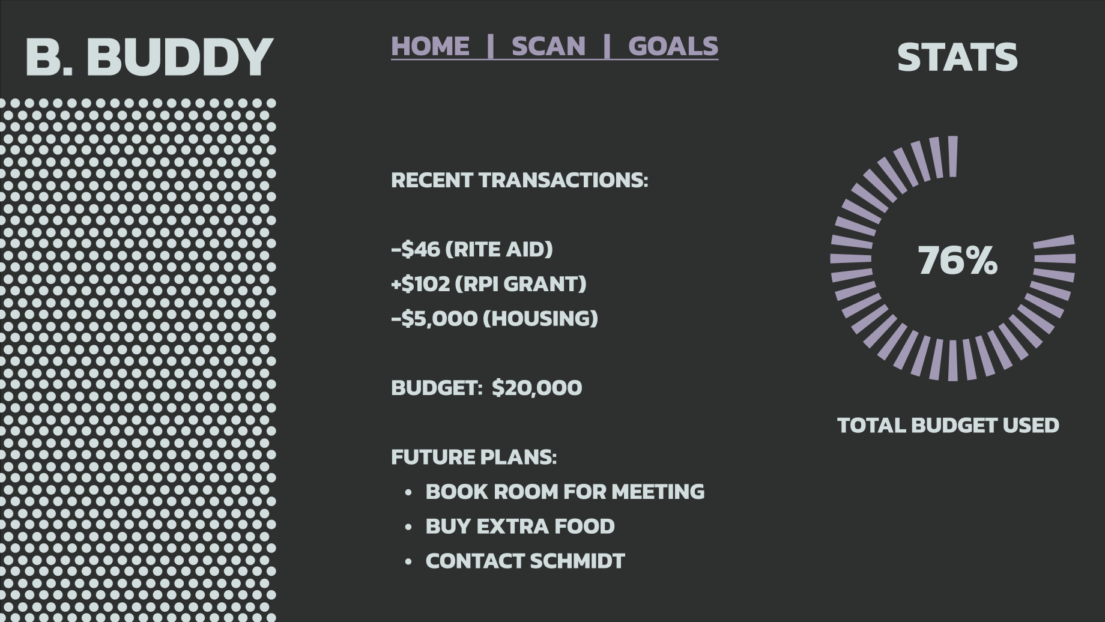
WIREFRAMES (HOME PAGE)
Notes:
Josh B.

Slide 17
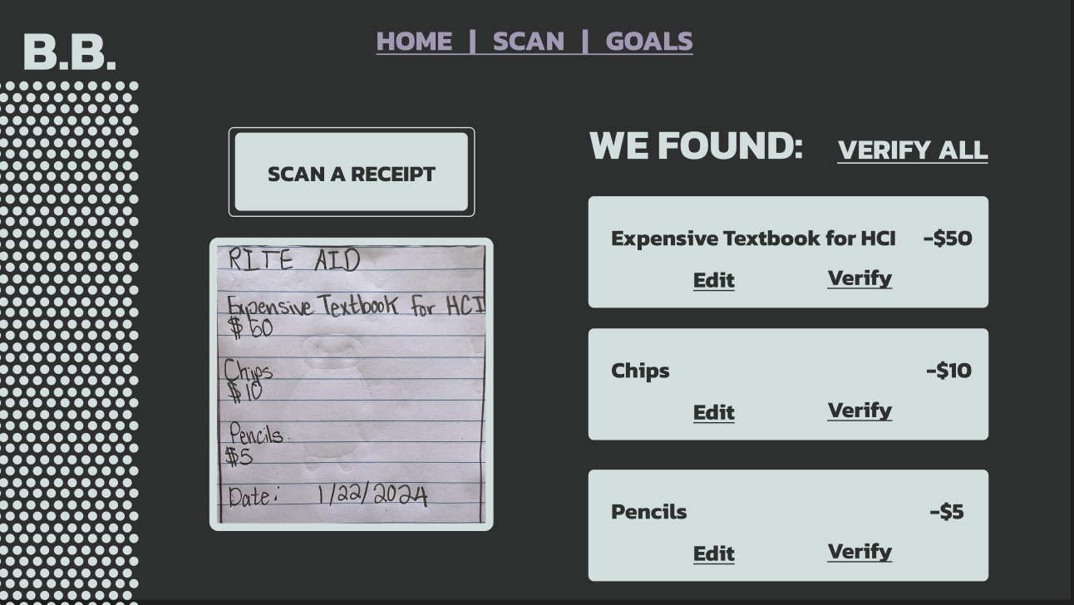
WIREFRAMES (SCANNING PAGE)
Notes:
Josh B.

Slide 18
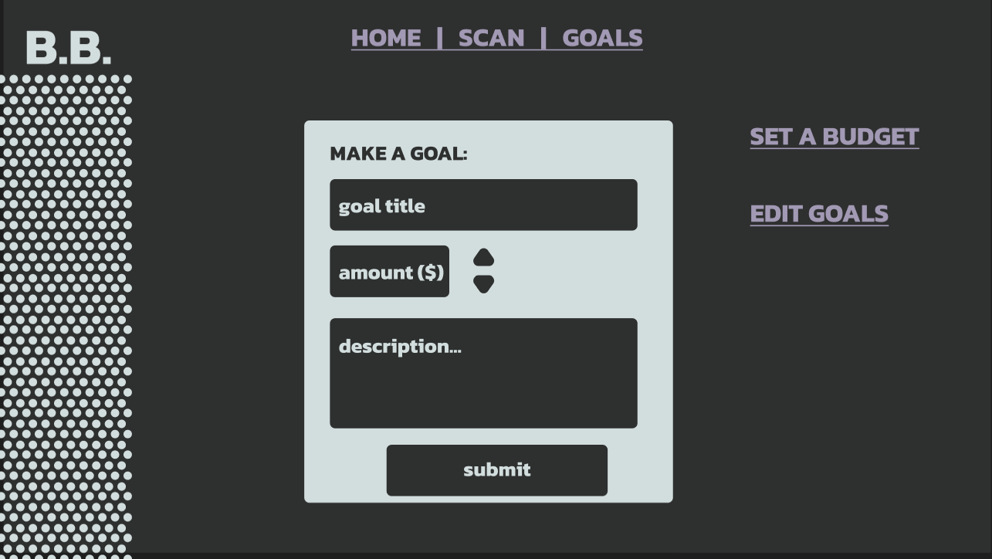
WIREFRAMES (GOALS PAGE)
Notes:
Josh B.

Slide 19
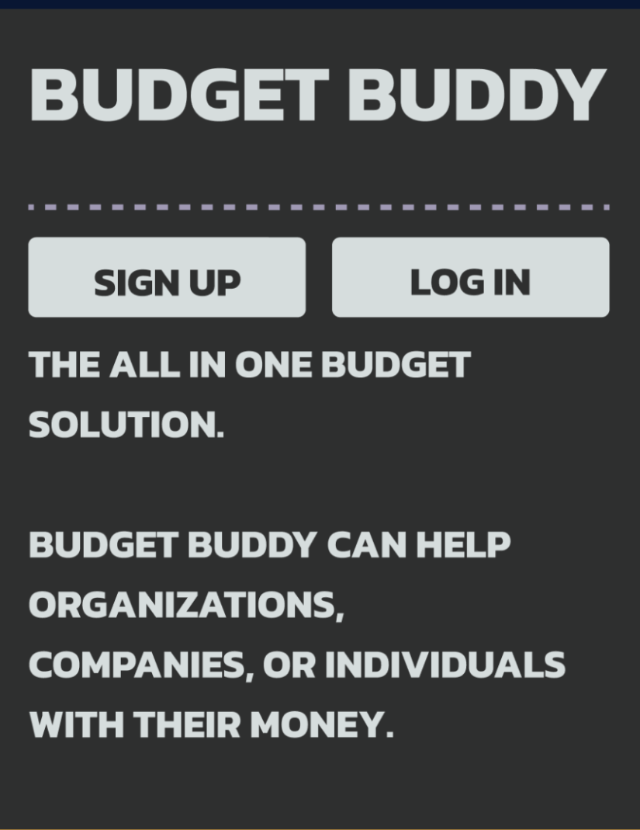
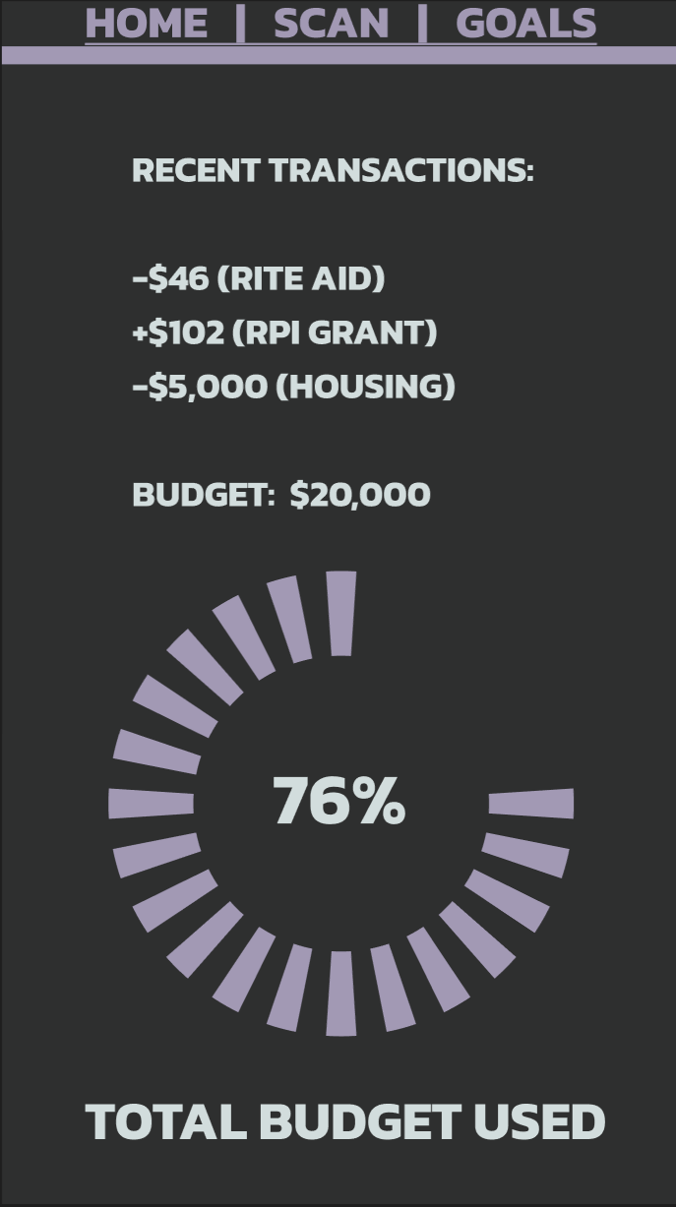

Slide 20
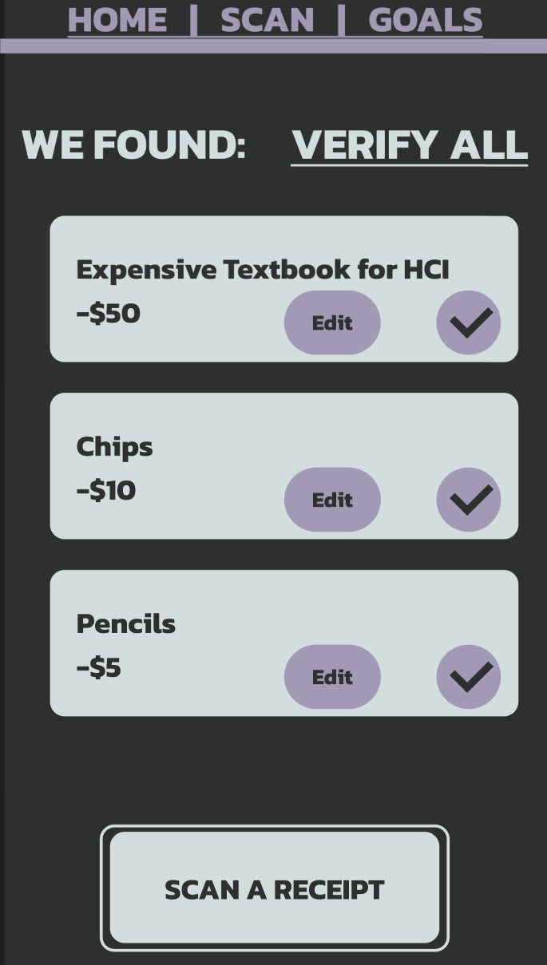
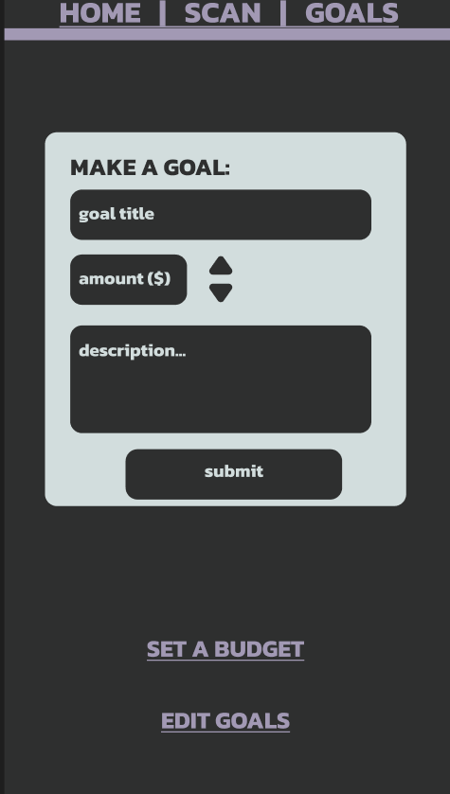
Notes:
Josh B.

Slide 21


MOVIE TIME
Be prepared to be blown away…
Notes:
Josh J.

Slide 22

THANKS FOR LISTENING

